Slide 1
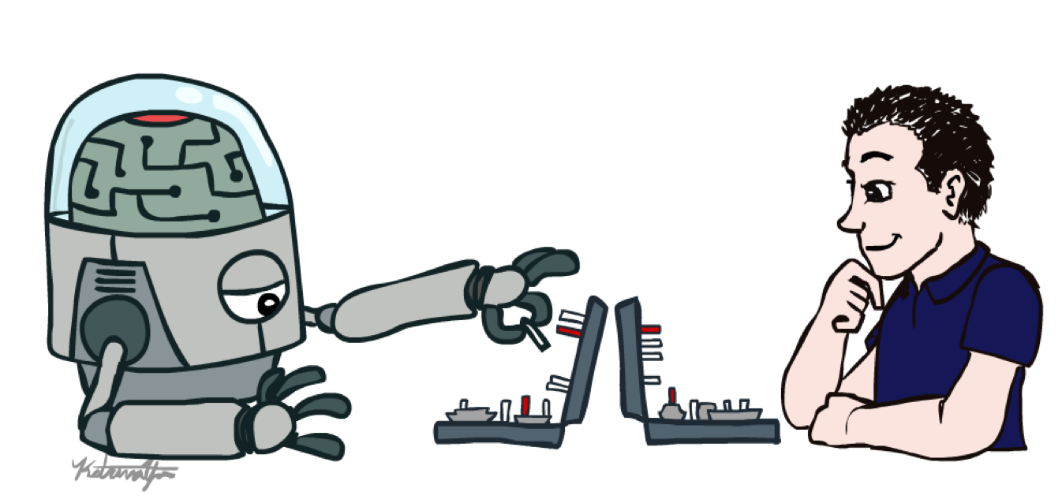
2022 Winter
UPDATA AI Study
Chap 1. Basic Concepts in AI & ML

Slide 2
Study Introduction
허준환 (junhwan26@korea.ac.kr)
매주 금 16시~18시
Ref: COSE361의 자료를 기준으로 하되 이해를 도울 수 있는 자료 CS188에서 발췌
22-1 김현우 교수님 COSE361
CS188 : https://inst.eecs.berkeley.edu/~cs188/fa22/

Slide 3
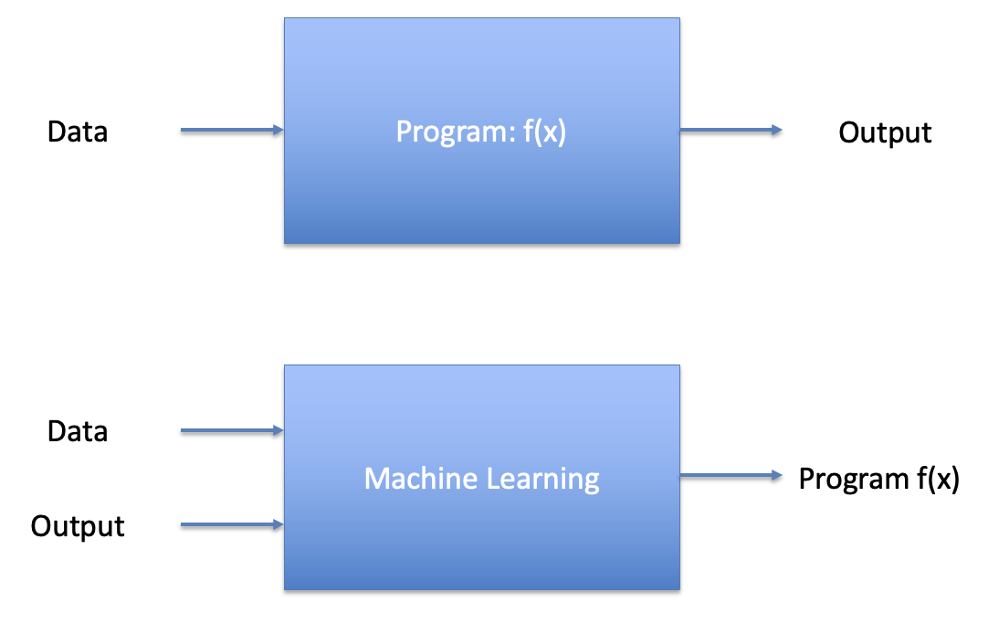
Programming vs ML
Keywords
X: Input, covariates, predictors, independent variable, features
Y: Output, label, dependent variable, response variable.
Model f: X->Y

Slide 4
Regression
Given
Learn a function:

Slide 5
Simple Linear Regression
Income
Education

Slide 6
Multple(multivariate) Linear Regression
Income
Education
Age

Slide 7
General Linear Regression
Income
Happiness
Education
Education
Age
Age

Slide 8
General Linear Regression
Income
Happiness
Education
Education
Age
Age

Slide 9
Estimation
Income
Education

Slide 10
Performance Measure
Loss Function or Objective Function

Slide 11
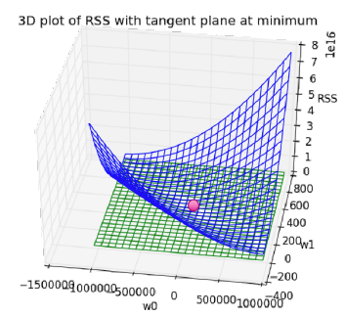
Minimizing the cost (Optimization)
Gradient Descent

Slide 12
Stochastic Gradient Descent

Slide 13
Simple Linear Regression
Income
Education

Slide 14
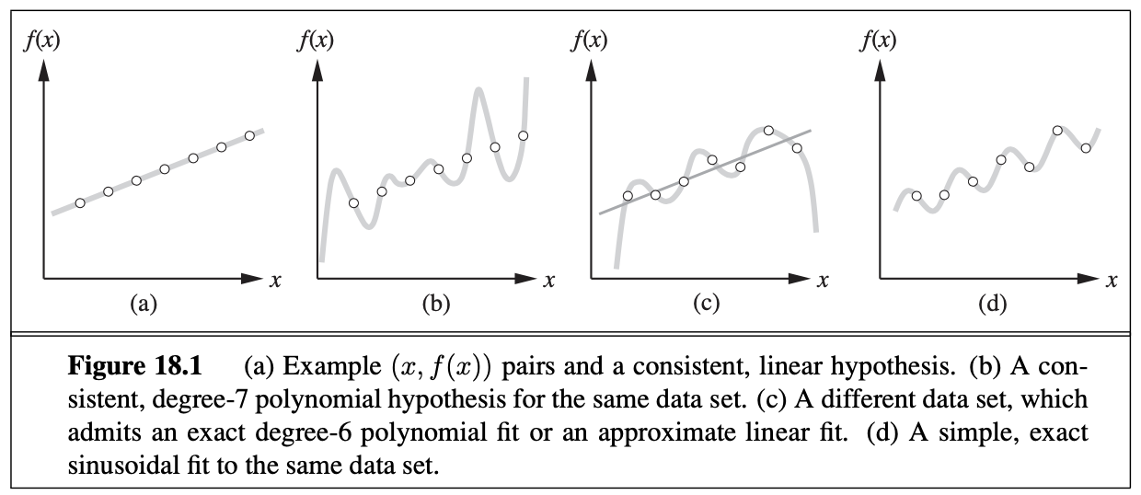
Overfitting and Ockham’s razor
AIMA 18.2: One answer is to prefer the simplest hypothesis consistent with the data. This principle is called Ockham’s razor

Slide 15
Performance Measure
“ML” Coined by Arthur Samuel
Samuel Checkers-playing Program
ML is a Field of study that gives computers the ability to learn
without being explicitly programmed (1959)
Well-posed learning problem by Tom Mitchell
A computer program is said to learn from experience E w.r.t. some task T and some performance measure P, if its performance on T as measured by P, improves w/ experience E.
Task T
Experience E
Performance P

Slide 16
Performance Measure
Improve on task T, with respect to performance metric P, based on experience E
T: Playing checkers
P:
E:
T: Recognizing hand-written words
P:
E:
T: Driving on four-lane highways using vision sensors
P:
E:
T: Categorize email messages as spam or legitimate.
P:
E:

Slide 17
Examples of ML problems
Pattern recognition
Face ID
Speech recognition
Medical Images
Spam Filtering
Optical Character Recognition (OCR)
…
Generating Patterns
Generating images, music, motion sequences
Generating News, novels, articles
Text-to-speech (TTS)
…

Slide 18
Examples of ML problems
Recognizing anomalies:
Unusual credit card transactions
Unusual network traffics
Unusual patterns of signals from sensors at factories, power plants
…
Planning/decision making
Learn how to play games
AlphaGo, AlphaStar
Prediction:
Predict future stock prices
Currency exchange rates
Disease progression
…

Slide 19
Type of Learning
Supervised learning
Training data + desired labels
Unsupervised learning
Training data (w/o desired labels)
Semi-supervised learning
Training data + a few desired outputs
Reinforcement learning
Rewards from sequence of actions

Slide 20
Supervised Learning: Regression
Given
Learn a function:

Slide 21
Supervised Learning: classification
Given
Learn a function:

Slide 22
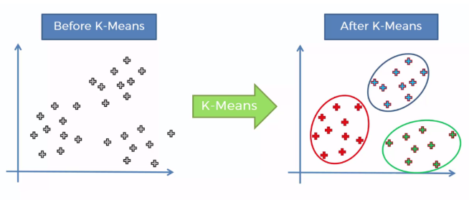
Unsupervised Learning
Given
Find clusters (or hidden structure of X)
Clustering, Dimensionality Reduction
https://www.kaggle.com/cdabakoglu/clustering-mall-customers-k-means

Slide 23
Reinforcement Learning
Given a sequence of states and actions with
(delayed) rewards, output a policy
Policy is a mapping from state -> actions that
tells you what to do in a given state
Examples:
Game playing
Robot in a maze
Balance a pole on your hand

Slide 24
The Agent-Environment Interface
Agent and environment interact at discrete time steps : t = 0, 1, 2, …, K
Agent observes state at step t :
produces action at step t :
gets resulting reward :
and resulting next state :
Slide credit: Sutton & Barto

Slide 25
Training vs Test Distribution
Assumption: training/test examples are independently drawn from the same overall distribution.
If examples are not independent, requires
collective classification
If test distribution is different, requires
transfer learning
Slide credit: Ray Mooney

